Slide 1
KEYLOGGER
CAPSTONE PROJECT
Presented By:
M.Gayathri – Mount Zion College Of Engineering And Technology
BE(CSE)

Slide 2
OUTLINE
Problem Statement
Proposed System/Solution
System Development Approach
Algorithm & Deployment
Result
Conclusion
Future Scope
References

Slide 3
PROBLEM STATEMENT
Develop a graphical user interface (GUI) application to start and stop a keylogger. The keylogger should capture keystrokes and display a message indicating its status.

Slide 4
PROPOSED SOLUTION
A GUI application will be developed using Tkinter, a Python library for creating GUI applications. The application will have two buttons: "Start" and "Stop". When the "Start" button is clicked, the keylogger will begin capturing keystrokes, and when the "Stop" button is clicked, the keylogger will stop capturing keystrokes. Additionally, the GUI will display a message indicating the status of the keylogger.

Slide 5
SYSTEM APPROACH
Design a GUI using Tkinter with two buttons: "Start" and "Stop", and a label to display the status message.
Implement functions to start and stop the keylogger.
Integrate the keylogger functionality using a library like pynput.
Configure the GUI buttons to call the respective functions.
Update the status message on the GUI accordingly.

Slide 6
ALGORITHM & DEPLOYMENT
.
Import the necessary libraries: tkinter for GUI, pynput for keylogger functionality.
Define functions start_keylogger() and stop_keylogger() to start and stop the keylogger respectively.
Inside the start_keylogger() function, initialize the keylogger listener.
Inside the stop_keylogger() function, stop the keylogger listener.
Update the GUI label to reflect the status of the keylogger.
Configure buttons to call the respective functions.
Deploy the application by running the Python script.

Slide 7
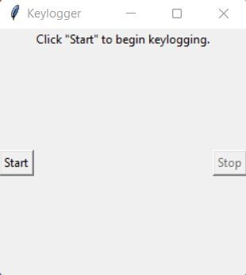
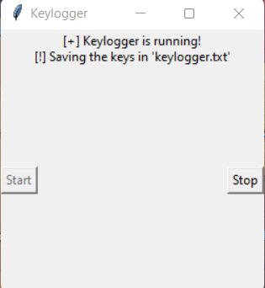
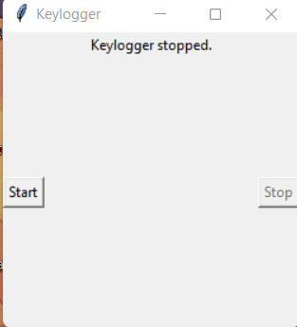
RESULT
The application will display a GUI with "Start" and "Stop" buttons. Clicking the "Start" button will activate the keylogger, and clicking the "Stop" button will deactivate it. The status message will update accordingly.

Slide 8
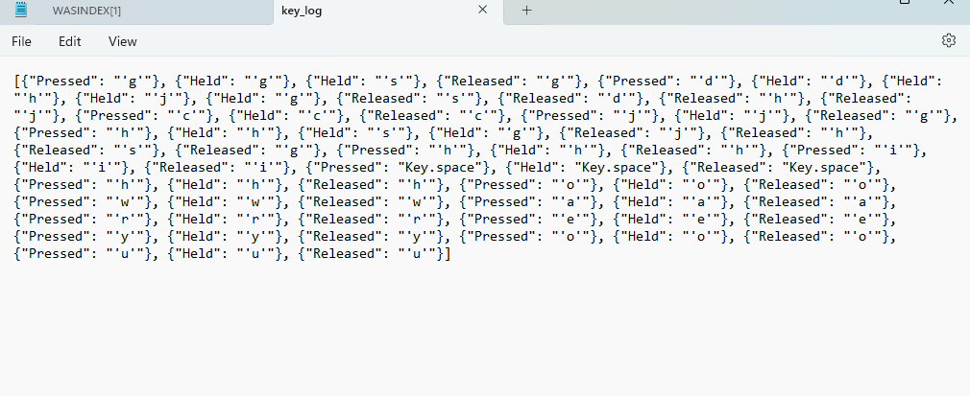
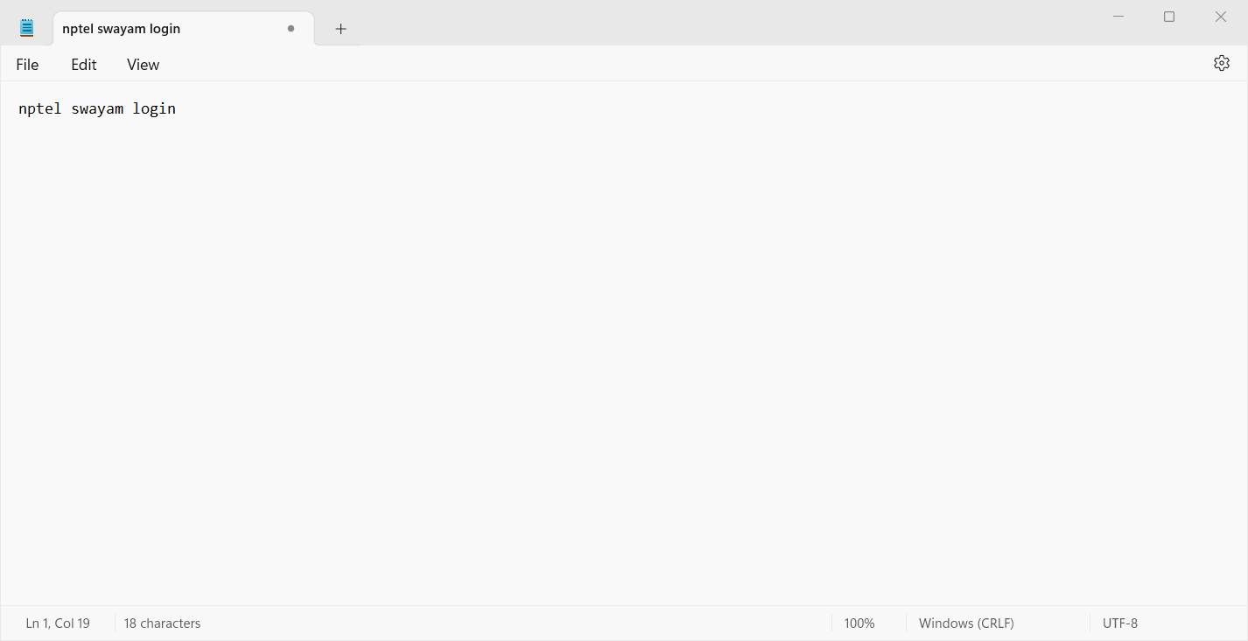
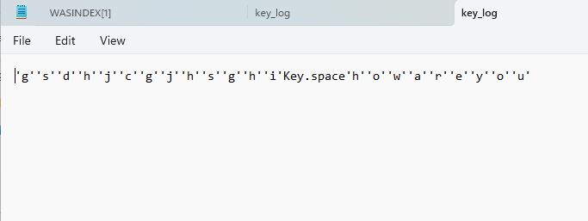
OUTPUT

Slide 9
CONCLUSION
The developed application provides a simple and user-friendly interface for controlling a keylogger. It effectively demonstrates the integration of GUI with keylogger functionality.

Slide 10
FUTURE SCOPE
Enhance the GUI with additional features such as logging functionality to save keystrokes to a file.
Implement encryption for securing the logged keystrokes.
Add functionality to customize keylogger settings such as log file location and log format.
Improve error handling and user feedback mechanisms.
Extend the application to support monitoring of mouse events along with keystrokes.

Slide 11
REFERENCES
Tkinter documentation: https://docs.python.org/3/library/tkinter.html
pynput documentation: https://pynput.readthedocs.io/en/latest/

Slide 12
THANK YOU

